Slide 1
Data Structures and Algorithms
Lecture 5&6

Slide 2
Learning Objectives:
Representation of Queue (or) Implementation of Queue
Queue using Array
Queue operations using array
Queue using Linked list
Applications of Queue
CIRCULAR QUEUE
Representation of Circular Queue
Operations on Circular queue

Slide 3
QUEUE:
A queue is linear data structure and collection of elements.
A queue is another special kind of list, where items are inserted at one end called the rear and deleted at the other end called the front.
The principle of queue is a “FIFO” or “First-in-first-out”.

Slide 4
QUEUE:
Queue is an abstract data structure.
A queue is a useful data structure in programming.
It is similar to the ticket queue outside a cinema hall, where the first person entering the queue is the first person who gets the ticket.

Slide 5
Real-world examples of queue

Slide 6

A real-world example of queue can be a single-lane one-way road, where the vehicle enters first, exits first.
03

Slide 7
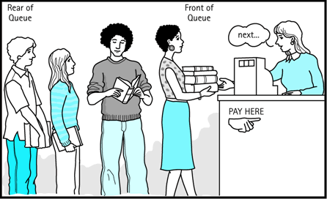
More real-world examples can be seen as queues at the ticket windows and bus-stops and our college library.

Slide 8
Operations on QUEUE

Slide 9
QUEUE:
The operations for a queue are analogues to those for a stack; the difference is that the insertions go at the end of the list, rather than the beginning.
A queue is an object or more specifically an abstract data structure (ADT) that allows the following operations:
Enqueue or insertion
Dequeue or deletion
03

Slide 10
QUEUE:
Operations on QUEUE:
A queue is an object or more specifically an abstract data structure (ADT) that
allows the following operations:
Enqueue or insertion:
which inserts an element at the end of the queue.
Dequeue or deletion:
which deletes an element at the start of the queue.

Slide 11
QUEUE:
Queue operations work as follows:
1. Two pointers called FRONT and REAR are used to keep track of the first and last elements in the queue.
2. When initializing the queue, we set the value of FRONT and REAR to 0.
03

Slide 12
QUEUE:
Queue operations work as follows:
3. On enqueing an element, we increase the value of REAR index and place the new element in the position pointed to by REAR.
4. On dequeueing an element, we return the value pointed to by FRONT and increase the FRONT index.
03

Slide 13
QUEUE:
Queue operations work as follows:
5. Before enqueing, we check if queue is already full.
6. Before dequeuing, we check if queue is already empty.

Slide 14
QUEUE:
Queue operations work as follows:
7. When enqueing the first element, we set the value of FRONT to 1.
8. When dequeing the last element, we reset the values of FRONT and REAR to 0.
Chapter

Slide 15
Representation of Queue (or) Implementation of Queue

Slide 16
The queue can be represented in two ways:
Queue using Array
2. Queue using Linked List
Chapter

Slide 17
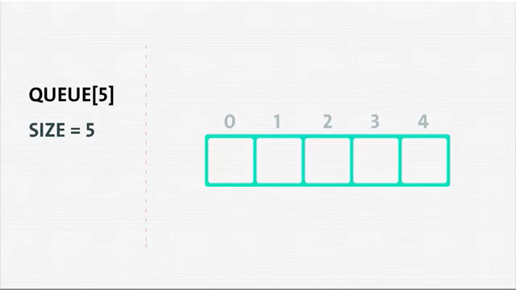
Simple queue mechanism

Slide 18
1.Queue using Array:
To overcome the problem of it is not possible to insert a new element even though there are two vacant positions in the linear queue.
the elements of the queue are to be shifted towards the beginning of the queue so that it creates vacant position at the rear end.
Then the FRONT and REAR are to be adjusted properly.
03

Slide 19
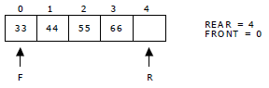
1.Queue using Array:
The element 66 can be inserted at the rear end. After this operation, the queue status is
as follows:
This difficulty can overcome if we treat queue position with index 0 as a position that
comes after position with index 4 i.e., we treat the queue as a circular queue.

Slide 20
Applications of Queue

Slide 21
Applications of Queue:
1. It is used to schedule the jobs to be processed by the CPU.
2. When multiple users send print jobs to a printer, each printing job is kept in the printing queue. Then the printer prints those jobs according to first in first out (FIFO) basis.
3. Breadth first search uses a queue data structure to find an element from a graph.
Chapter

Slide 22
Queue operations using array

Slide 23
Queue operations using array:
1. enqueue() or insertion():which inserts an element at the end of
the queue.
Algorithm: Procedure for insertion():
Step-1:START
Step-2: if rear==max-1 then
Write ‘Queue is full’
Step-3: otherwise
3.1: read element ‘queue[rear]’
Step-4:STOP
Chapter
03

Slide 24
Queue operations using array:
2. dequeue() or deletion(): which deletes an element at the start of
the queue.
Algorithm: procedure for deletion():
Step-1:START
Step-2: if front==rear+1 then
Write’ Queue is empty’
Step-3: otherwise
3.1: print deleted element
Step-4:STOP
Chapter

Slide 25
Queue operations using array:
3. display(): which displays an elements in the queue.
Algorithm: procedure for display():
Step-1:START
Step-2: if front==rear+1 then
Write’ Queue is empty’
Step-3: otherwise
3.1: for i=front to rear then
3.2: print ‘queue[i]’
Step-4:STOP

Slide 26
CIRCULAR QUEUE

Slide 27
Circular Queue:
A more efficient queue representation is obtained by regarding the array Q[MAX] as circular.
Any number of items could be placed on the queue.
This implementation of a queue is called a circular queue because it uses its storage array as if it were a circle instead of a linear list.

Slide 28
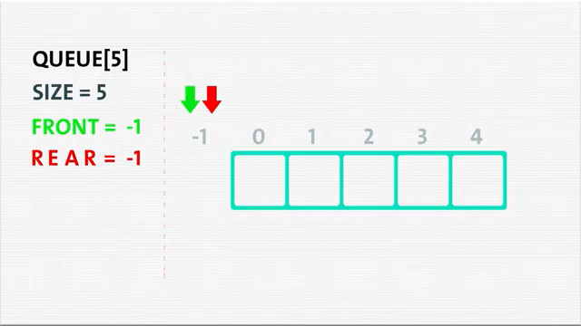
Circular queue mechanism

Slide 29
Circular Queue:
There are two problems associated with linear queue.
They are:
Time consuming: linear time to be spent in shifting the elements to the beginning of the queue.
Signaling queue full: even if the queue is having vacant position.

Slide 30
Operations on Circular queue

Slide 31
Queue using Linked list

Slide 32
2. Queue using Linked list:
We can represent a queue as a linked list.
In a queue data is deleted from the front end and inserted at the rear end.
We can perform similar operations on the two ends of a list.
We use two pointers front and rear for our linked queue implementation.
Chapter

Slide 33
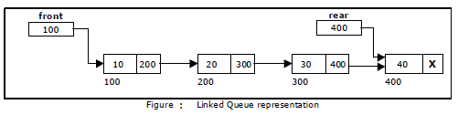
2. Queue using Linked list:
The linked queue looks as shown in figure:
03

Slide 34
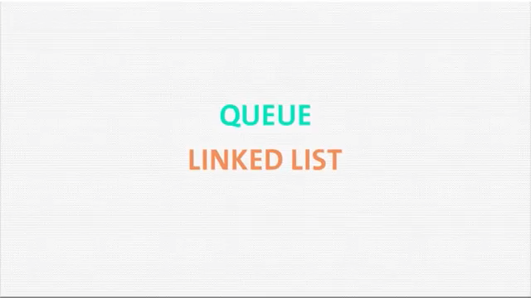
Linked list v-Methodology

Slide 35
Applications of Queue

Slide 36
Applications of Queue:
1. It is used to schedule the jobs to be processed by the CPU.
2. When multiple users send print jobs to a printer, each printing job is kept in the printing queue. Then the printer prints those jobs according to first in first out (FIFO) basis.
3. Breadth first search uses a queue data structure to find an element from a graph.
Chapter

Slide 37
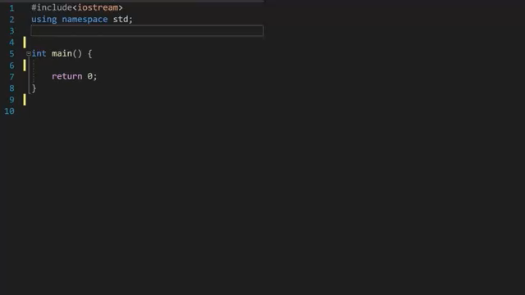
Linked List – Program

Slide 38
Thank you

